Slide 1







PATHOLOGY LAB
BY YASHVI KHOKHARIYA(088)
VRUNDA PALADIYA(123)
SHREYA PATEL(145)
SHRADHHA TIWARI(208)

Slide 2


CONTENT
Introduction
Objectives
Analysis
Project Profile
Features
Requirement Specification
Current System
Proposed System
Hardware & Software use

Slide 3
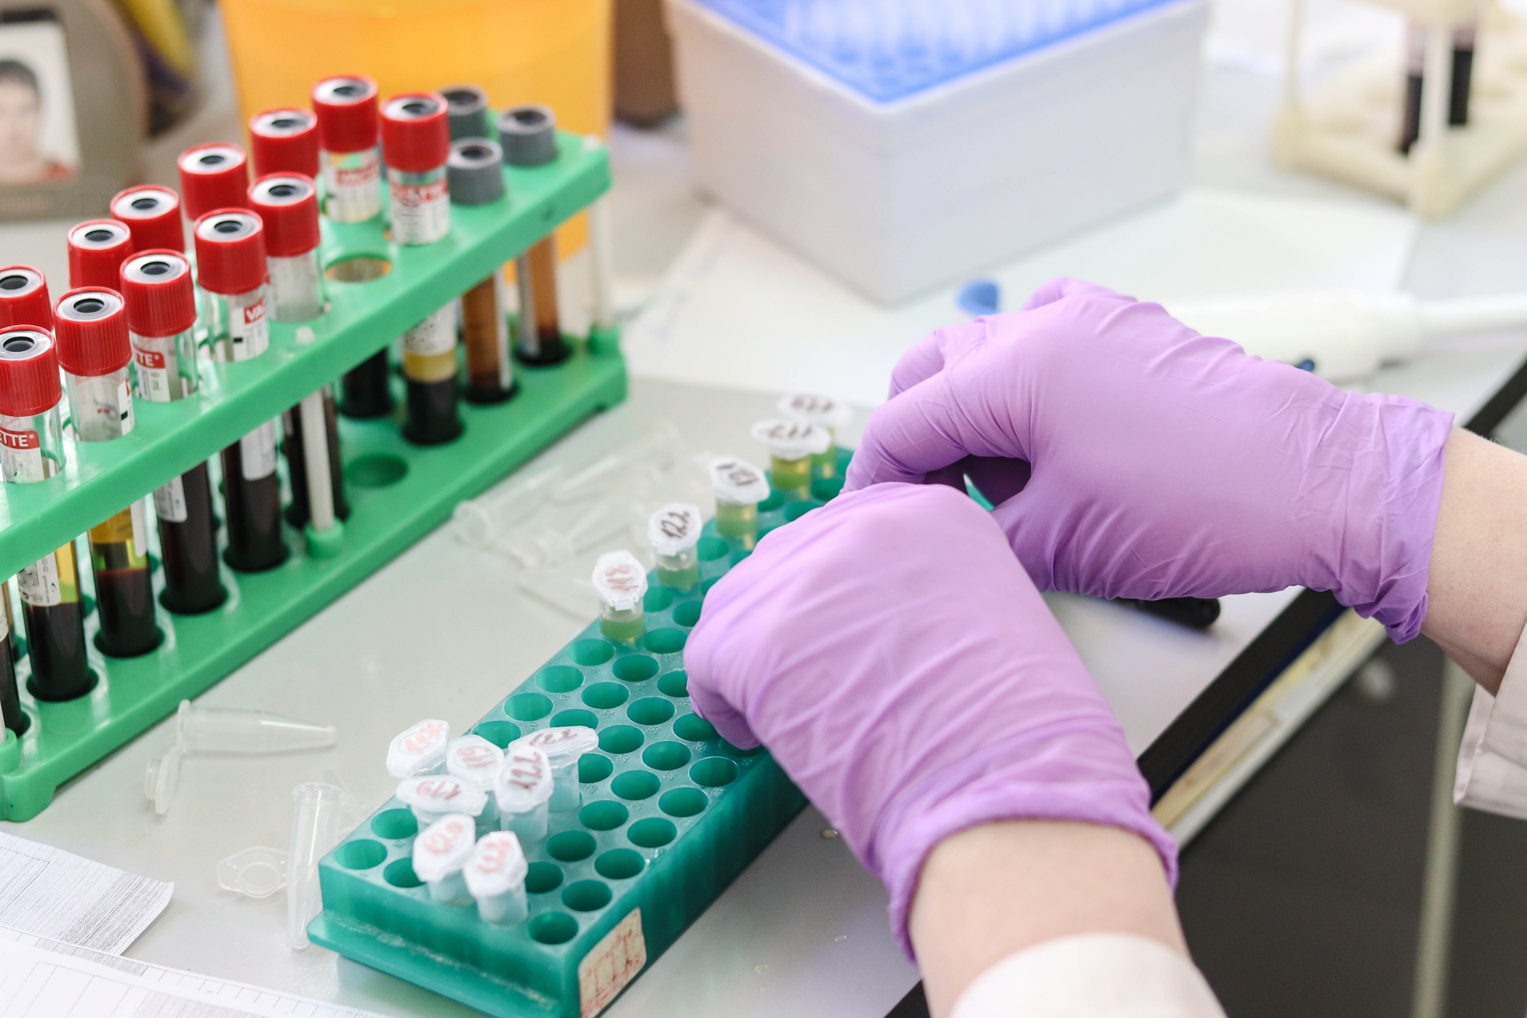
Contents
01
Introduction
The project aims to develop a website that allows users to easily access lab reports online, reducing the need for manual effort and travel. Users can obtain their reports anytime, while administrators can efficiently maintain patient history.
02
Objectives
To develop a website that allows users to easily access their pathology lab reports online, minimizing manual effort and travel. The system will also facilitate test booking, and doctor appointments, providing convenience and efficiency for both patients and administrators in managing patient history and services.
03
Analysis
The project aims to develop an online pathology lab system that simplifies access to lab reports and test booking for users. The existing systems in pathology labs often require manual effort and time to retrieve reports and book tests, presenting limitations in accessibility and ease of use. The proposed system seeks to overcome these limitations by enabling online report access, test bookings. Additionally, the system will feature an organized database for secure patient information storage, reducing manual paperwork and improving accuracy. This will lead to faster transactions, reduced human errors, and improved decision-making through reliable data management.

Slide 4




PROJECT PROFILE
Pathology is the study of the causes and effects of disease or injury. The word pathology also refers to the study of disease in general, incorporating a wide range of biology research fields and medical practices.
There are teams of medical staff and scientists whose job it is to study samples from a person’s body to understand what’s making them unwell.
Doctors and scientists working in pathology are experts in illness and disease. They use their expertise to support every aspect of healthcare, from guiding doctors on the right way to treat common diseases, to using cutting-edge genetic technologies to treat patients with life-threatening conditions.

Slide 5
FEATURES
01
01
Project are categorized into Admin, Staff, Doctor, User.
02
02
03
Online test booking
03
Report Hisory and Comparison
04
04
Report Sharing
05
05
Multi-role Access Control Define different levels of access for admin, staff, doctors, and users, ensuring proper data security and role management

Slide 6




REQUIREMENT SPECIFICATION
FUNCTIONAL REQUIREMENT (ADMIN)
FUNCTIONAL REQUIREMENT (STAFF)
FUNCTIONAL REQUIREMENT (DOCTOR)
FUNCTIONAL REQUIREMENT (USER)
User can login/register.
Doctor manage their profile.
User can select test.
User can book Appointment.
User can view report.
·Admin can login/register.
·Admin can manage profile.
·Admin can insert, update, delete and view user.
·Admin can insert, update, delete and view staff.
·Admin can insert, update, delete and view test.
·Admin can insert, update, delete and view service.
·Staff can login/register.
·Doctor manage their profile.
·Staff can insert, update, delete and view doctor.
Staff can insert, update, delete and view staff.
·Doctor can login/register.
·Doctor manage their profile.
·Doctor can approve appointments.
·Doctor can cancel appointment.
·Doctor can generate reports.

Slide 7
CURRENT SYSTEM
In the existing online pathology lab, users don’t need to waste a lot of time and physical effort in getting your reports done and proper information is provided to the user regarding the event details like food, decoration, and budget. All the information is maintained in records which are difficult to view or modify.
LIMITATIONS OF CURRENT SYSTEM
In the existing pathology lab system the problem faced by the user are following:
·This System provides only limited tests which are specialties
·Hard to manage
·Choosing right test
PROPOSED SYSTEM
The proposed Pathology Lab system provides a smart way to users in booking the tests for the reports. The user can book the test from anywhere and at any time which saves a lot of time and not the physical effort is required. All the details given users are stored in the database with high-level security which can be checked frequently and can be modified at any time by authorized members of the application.

Slide 8

HARDWARE AND SOFTWARE USE
Server: A reliable server to host website and manage databases.
Client Devices: Desktop, laptop, or mobile devices for users to access the website.
Network Infrastructure: Stable internet connection to ensure smooth access to the website for users and administrators.
Backup Storage: External or cloud-based storage for backup of patient reports and data.
Operating System: Microsoft Windows 10 for development and deployment.
Frontend Development Tool: Microsoft Visual Studio 2019.
Backend Tool: SQL Server Management for database management.
Programming Language: ASP.NET with C# for dynamic website functionality.
Database Management System: MySQL for storing and retrieving patient data and lab reports.

Slide 9

Conclusions
The project successfully streamlines the process of accessing pathology lab reports by enabling patients to retrieve their reports online, reducing the need for manual effort and travel. By incorporating features like online test booking, user support, the system enhances user convenience. Additionally, the proposed system improves efficiency and accuracy in managing patient data, with minimal human intervention, leading to faster, more reliable results and decision-making. Overall, this system offers a modern solution to laboratory operations, benefiting both users and administrators.

Slide 10



DATABASE TABLES
admin_master
appoitment_master
blood_test
doctor_master
liver_test
pregnancy_test
rtpcr_test
service_master
staff_master
test_master
urine_test
user_master

Slide 11
THANK YOU

